Slide 1


Slide 1: Abstract
The provided Python code defines a class, PaymentReceiptGenerator, which serves to generate payment receipts for a store's transactions. The class allows users to input product details, including name, unit price, and quantity, and then generates a formatted payment receipt. The receipt includes customer information, a list of purchased products with individual and total prices, and is displayed in the console. The script, when run, prompts the user to enter product details iteratively until the user indicates completion. The generated payment receipt is then presented, featuring a visually structured format with asterisks and dashes for emphasis. The code demonstrates the use of exception handling for input validation and employs a user-friendly interface for creating and displaying payment receipts.

Slide 2

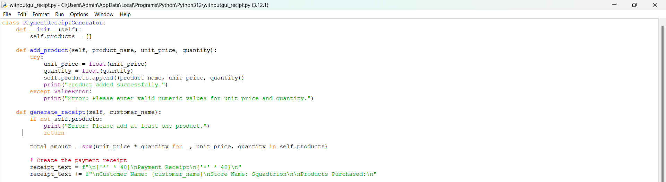
Slide 2: Code
class PaymentReceiptGenerator: def init(self): self.products = []
def add_product(self, product_name, unit_price, quantity):
try:
unit_price = float(unit_price)
quantity = float(quantity)
self.products.append((product_name, unit_price, quantity))
print("Product added successfully.")
except ValueError:
print("Error: Please enter valid numeric values for unit price and quantity.")
def generate_receipt(self, customer_name):
if not self.products:
print("Error: Please add at least one product.")
return
total_amount = sum(unit_price * quantity for _, unit_price, quantity in self.products)
# Create the payment receipt
receipt_text = f"\n{'*' * 40}\nPayment Receipt\n{'*' * 40}\n"
receipt_text += f"\nCustomer Name: {customer_name}\nStore Name: Squadtrion\n\nProducts Purchased:\n"

Slide 3

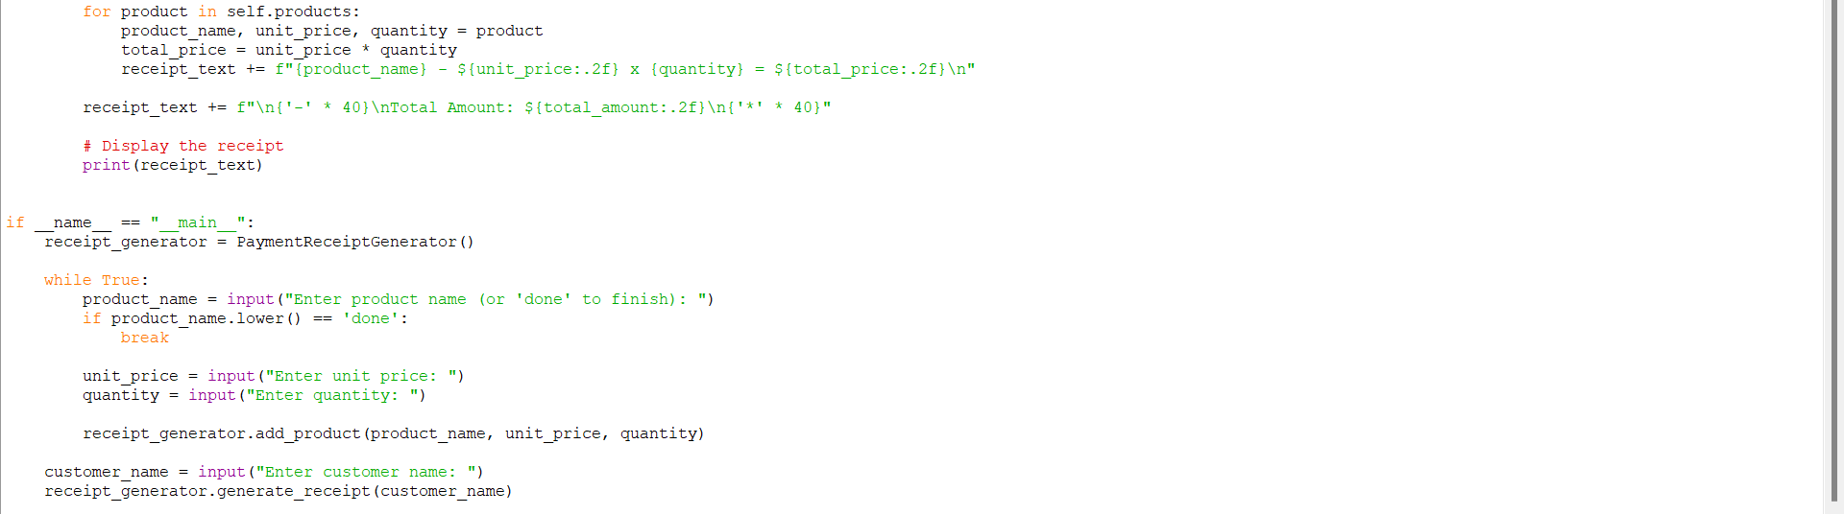
Slide 3: Code
for product in self.products: product_name, unit_price, quantity = product total_price = unit_price * quantity receipt_text += f"{product_name} - ${unit_price:.2f} x {quantity} = ${total_price:.2f}\n"
receipt_text += f"\n{'-' * 40}\nTotal Amount: ${total_amount:.2f}\n{'*' * 40}" # Display the receipt print(receipt_text)
if name == "main": receipt_generator = PaymentReceiptGenerator()
while True:
product_name = input("Enter product name (or 'done' to finish): ")
if product_name.lower() == 'done':
break
unit_price = input("Enter unit price: ")
quantity = input("Enter quantity: ")
receipt_generator.add_product(product_name, unit_price, quantity)
customer_name = input("Enter customer name: ")
receipt_generator.generate_receipt(customer_name)

Slide 4
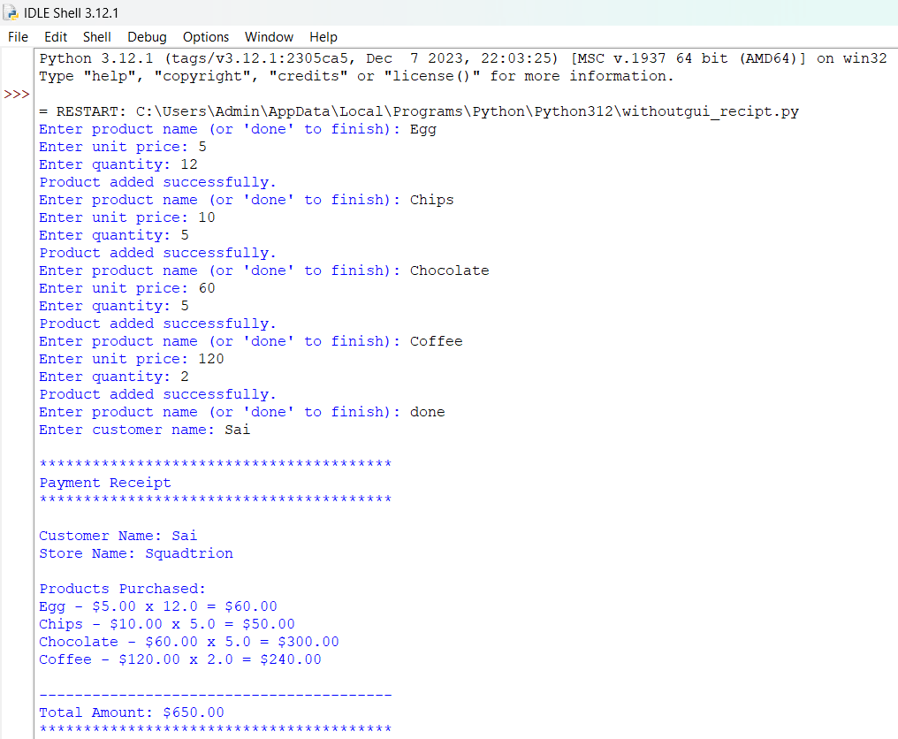
Slide 4: Output

Slide 5

Slide 5: Module Explanation
built-in module: input
Explanation: input is a built-in function in Python that reads a line from the user's input and returns it as a string.
built-in module: float
Explanation: float is a built-in function in Python that converts a string or a number to a floating-point number.
built-in module: print
Explanation: print is a built-in function in Python that is used to print messages or values to the console.
built-in module: if __name__ == "__main__":
Explanation: This is a common Python idiom used to check whether the Python script is being run as the main program or if it is being imported as a module. It allows you to control the execution of code depending on how the script is used.
String formatting using f-strings (f"...")
Explanation: f-strings are used for string formatting in Python. They allow you to embed expressions inside string literals, using curly braces {}. In this code, f-strings are used to format the payment receipt text.
Exception handling using try and except
Explanation: The try and except blocks are used for exception handling. It attempts to execute the code inside the try block, and if an exception (error) occurs, it is caught and handled in the except block. In this code, it is used to catch ValueError if the conversion of unit price or quantity to a float fails.

Slide 6

Slide 6: Module Explanation
__init__ method
Explanation: __init__ is a special method in Python classes that is called when an object is created. In this code, it initializes the PaymentReceiptGenerator class by setting up an empty list for storing products.
self
Explanation: self is a reference to the instance of the class. It is the first parameter in the method definitions of a class and is used to access instance variables. In this code, self.products is used to store the list of products.
while loop
Explanation: The while loop is used for repetitive execution of a block of code. In this code, it continues to prompt the user for product information until the user enters "done" for the product name.
sum function
Explanation: sum is a built-in function in Python that returns the sum of a sequence of numbers. In this code, it is used to calculate the total amount of the products.
break statement
Explanation: The break statement is used to exit a loop prematurely. In this code, it is used to exit the while loop when the user enters "done" for the product name.

